Slide 1


CMPE 135: Object-Oriented Analysis and Design September 5 Class Meeting
Department of Computer Engineering San Jose State University Fall 2017 Instructor: Ron Mak
www.cs.sjsu.edu/~mak

Slide 2
Team Projects
Rock-Paper-Scissors game program.
Well-written using good object-oriented design principles, of course.
OR: Choose a different team project.
It must also be well-written using good object-oriented design principles.
Either way: Team presentations and demos at the end of the semester.
Discuss your design.
Demonstrate that your code works.

Slide 3
Key Points Regarding Good Design
There is no magic formula.
Every good design is achieved after a journey.
It’s an iterative process.
Start with a workable initial design.
Each iteration builds upon working code to improve the design.

Slide 4
Key Points Regarding Good Design, cont’d
One good design technique: encapsulation.
Encapsulate the code that will vary.
Isolate the changes from the rest of the code.
Encapsulation supports code reliability and flexibility.
The design/code/test iterations are part of the overall “big picture” to develop a software application.
No “big bang”!

Slide 5
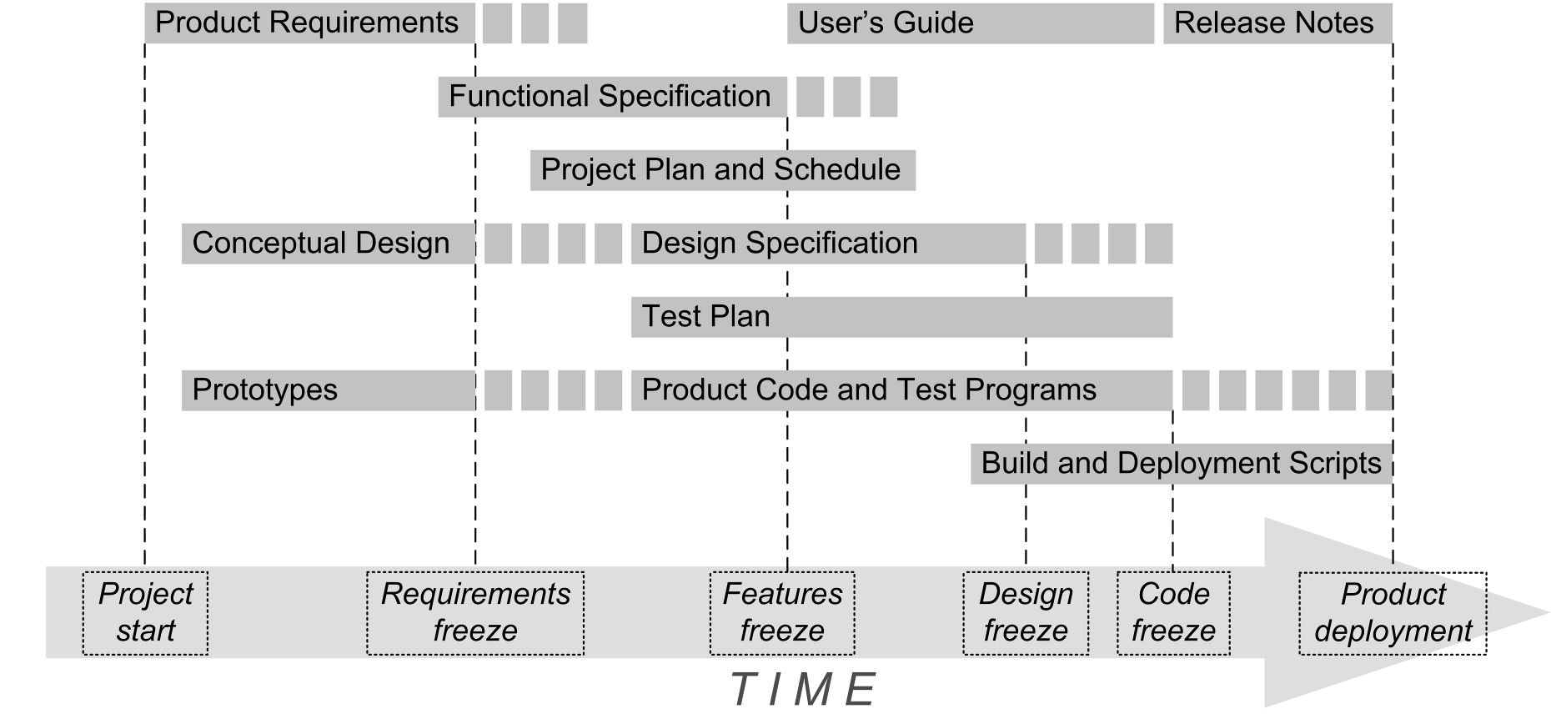
Application Development Big Picture

Slide 6
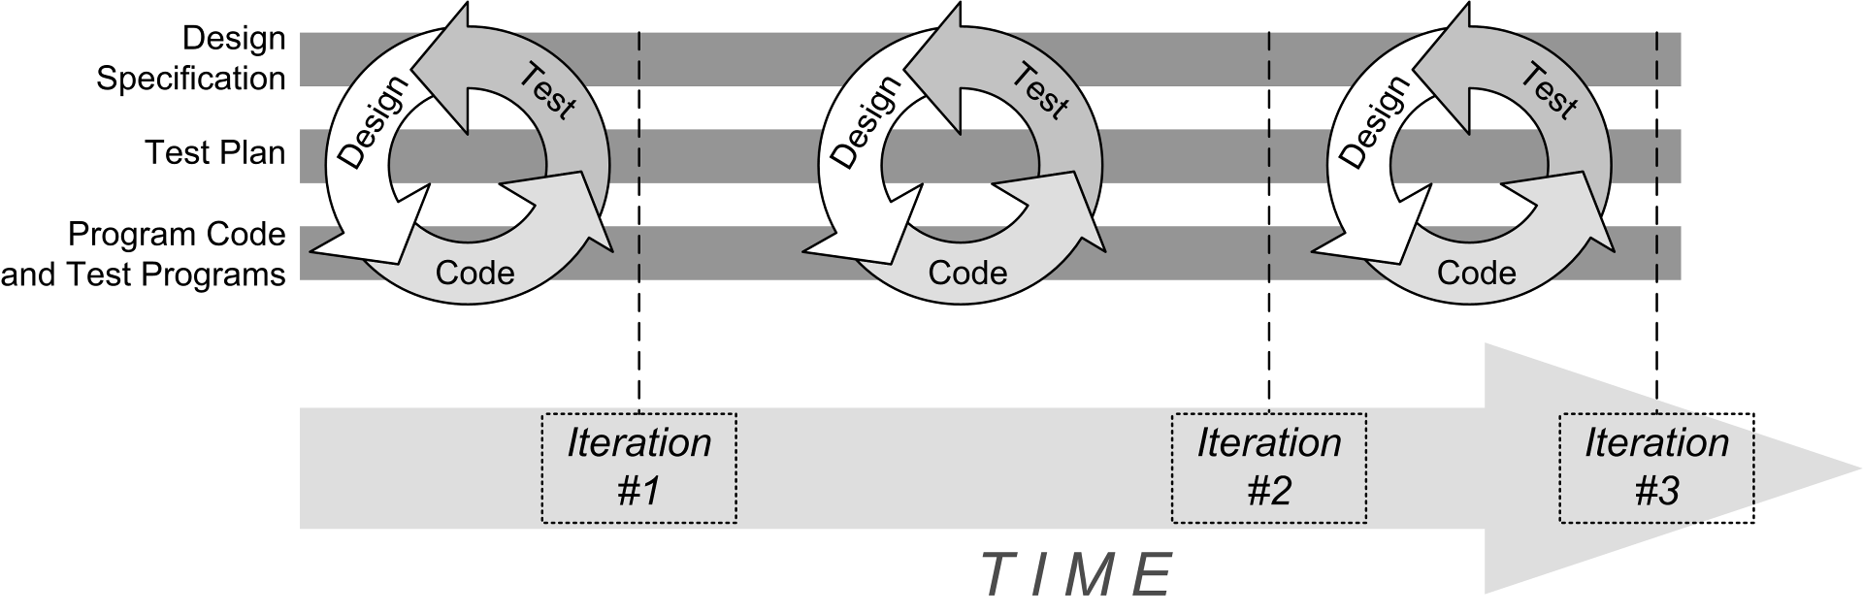
Iterative Development

Slide 7

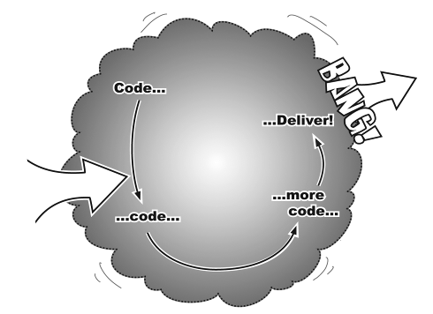
Incremental Development
Goal
Start
Each iteration adds functionality to code that already works.
No Big Bang!
Head First Object-Oriented
Analysis & Design
by Brett D. McLaughlin, et al.
O’Reilly, 2006.

Slide 8
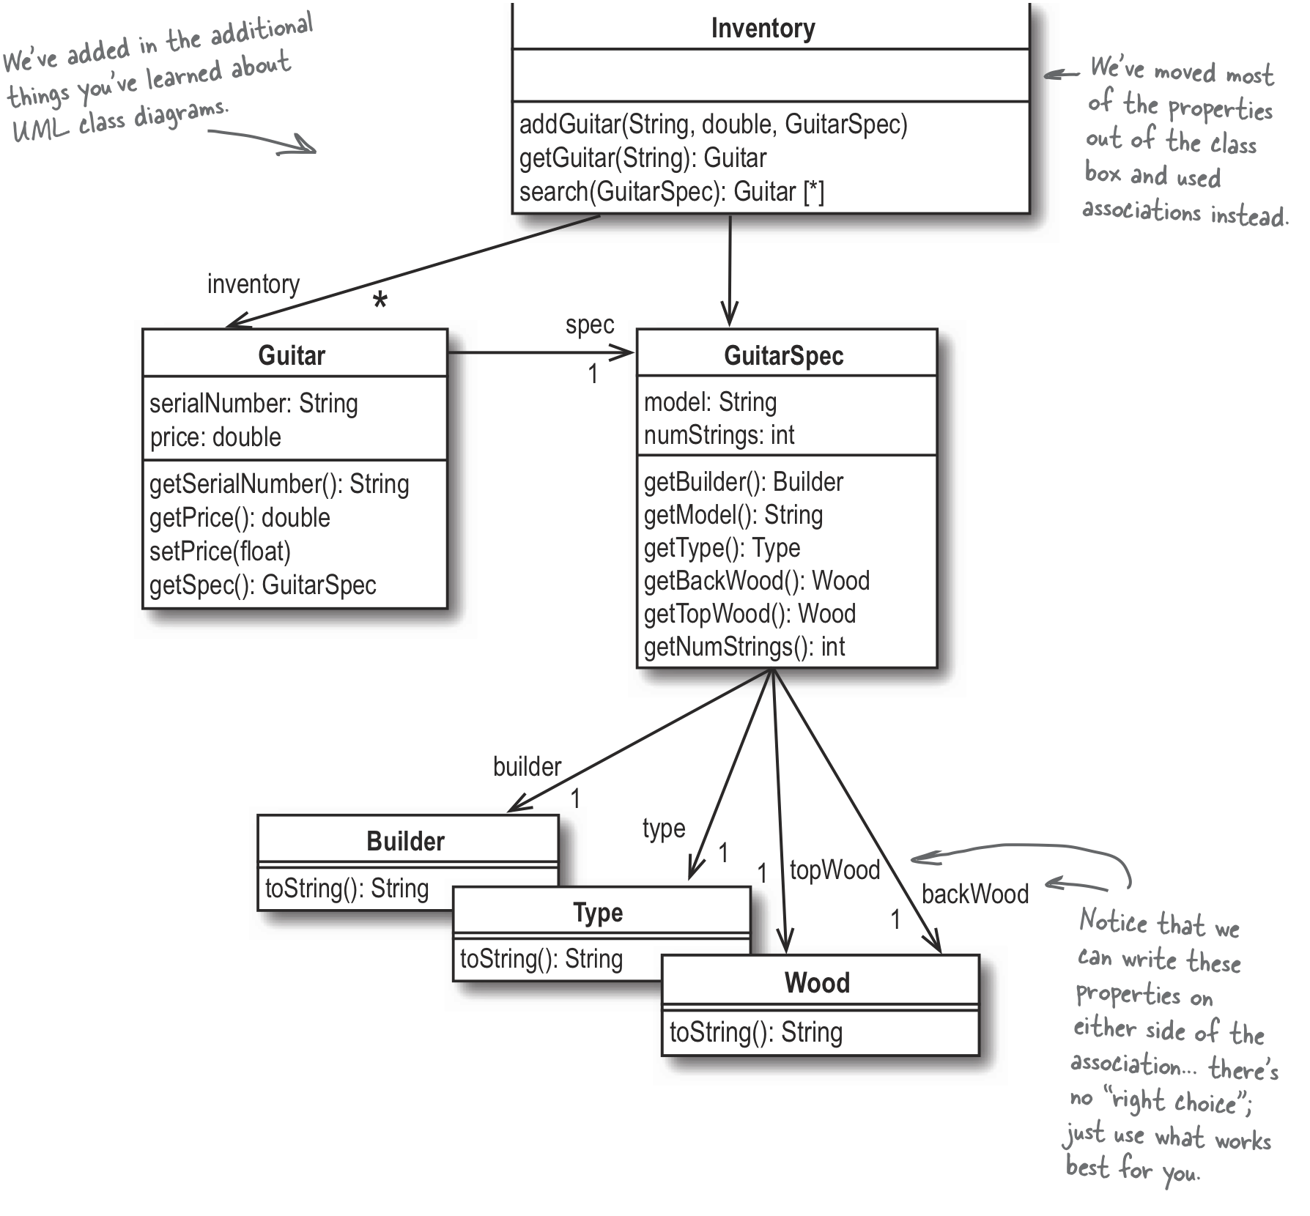
Rick’s Guitar Application
What made us
believe that this
is a good design?
matches(GuitarSpec *): bool
Head First Object-Oriented
Analysis & Design
by Brett D. McLaughlin, et al.
O’Reilly, 2006.

Slide 9
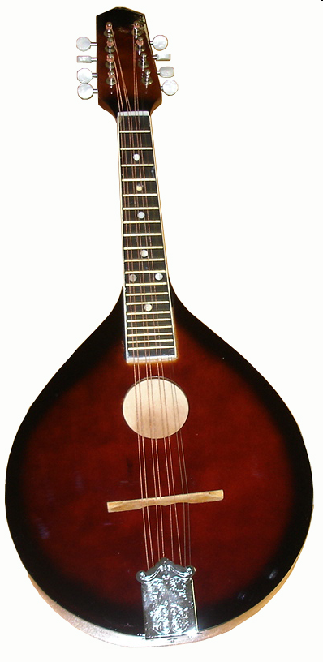
A New Requirement!
Rick changes the name of his shop to Rick’s Music.
He adds mandolins to the type of instruments he sells.
How easily can our software design accommodate this change?

Slide 10
Possible Mandolin Solutions
Add a Mandolin class.
Cut and paste code from the existing Guitar class.
Replace the Guitar class with an Instrument class.
A type field indicates whether the instrument is a guitar or a mandolin.
Add a new Instrument class.
Make the existing Guitar class and a new Mandolin class subclasses of the Instrument class.

Slide 11
Possible Mandolin Solutions, cont’d
Solution
Advantages
Disadvantages
Mandolin class
Simple to implement
Duplicate code
Hard to maintain
Instrument class with type field
No duplicate code
Not an O-O solution
Need to check type on objects
Instrument base class
O-O solution
No type field to check
No duplicate code
Does Rick have an Instrument in the inventory?
Head First Object-Oriented
Analysis & Design
by Brett D. McLaughlin, et al.
O’Reilly, 2006.

Slide 12
New Instrument Class
Add a new Instrument class.
Make the existing Guitar class and a new Mandolin class subclasses of the Instrument class.
Change the Inventory class to contain a list of Instrument objects instead of only Guitar objects.
Each Instrument object can be either a Guitar object or a Mandolin object.

Slide 13
New Instrument Class, cont’d
It doesn’t make sense to create Instrument objects directly.
Create only Guitar and Mandolin objects.
Therefore, make the Instrument class abstract.
Make the Instrument class the abstract base class of the Guitar and Mandolin subclasses.

Slide 14
Abstract Classes
An abstract class is a placeholder for the actual implementation classes.
The abstract class defines the behavior, and the subclasses implement that behavior.
The abstract class encapsulates shared behavior and defines the protocol for all its subclasses.

Slide 15
New InstrumentSpec Class
Add a new abstract InstrumentSpec class.
Base class for the GuitarSpec and MandolinSpec subclasses.
The Instrument class has a one-to-one association with the InstrumentSpec class.

Slide 16
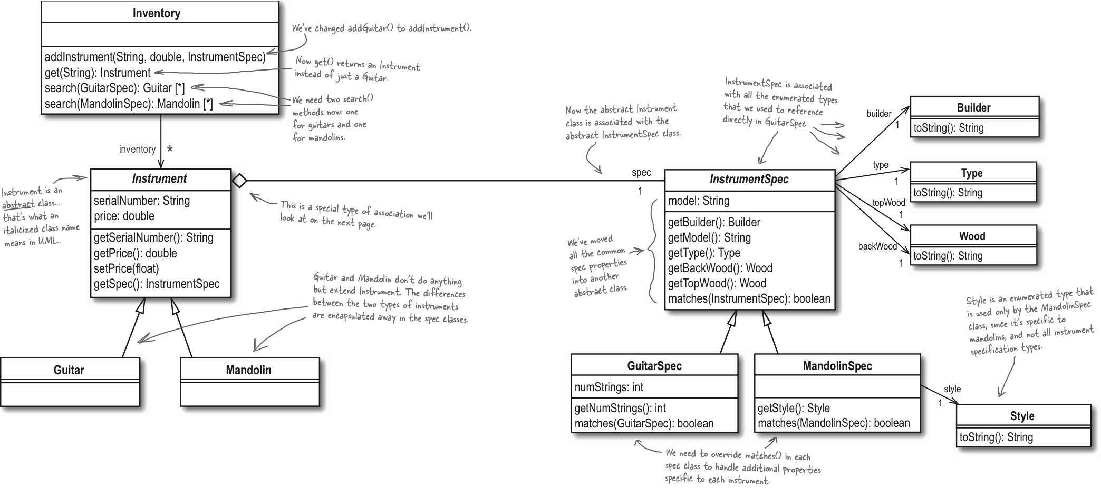

Next Iteration Design
Head First Object-Oriented
Analysis & Design
by Brett D. McLaughlin, et al.
O’Reilly, 2006.

Slide 17
New Instrument Class
#include <string>
#include "InstrumentSpec.h"
using namespace std;
class Instrument
{
private:
string serial_number, model;
double price;
InstrumentSpec *spec;
public:
Instrument(string serial_number, double price,
InstrumentSpec *spec);
string get_serial_number() const;
double get_price() const;
void set_price(float new_price);
InstrumentSpec *get_spec() const;
};

Slide 18
New InstrumentSpec Class
class InstrumentSpec
{
public:
InstrumentSpec(Builder builder, string model, Type type,
Wood back_wood, Wood top_wood);
Builder get_builder() const;
string get_model() const;
Type get_type() const;
Wood get_back_wood() const;
Wood get_top_wood() const;
bool matches(InstrumentSpec *other_spec);
private:
string model;
Builder builder;
Type type;
Wood back_wood, top_wood;
string to_lower(string str);
};
Common base class attributes.

Slide 19
New InstrumentSpec Class, cont’d
Match base class attributes only.
bool InstrumentSpec::matches(InstrumentSpec *other_spec)
{
if (builder != other_spec->builder) return false;
if ( (model != "")
&& (to_lower(model) != to_lower(other_spec->model))) return false;
if (type != other_spec->type) return false;
if (back_wood != other_spec->back_wood) return false;
if (top_wood != other_spec->top_wood) return false;
return true;
}

Slide 20
Revised Inventory Class
void Inventory::add_instrument(string serial_number, double price,
InstrumentSpec *spec)
{
Instrument *instrument = nullptr;
if (typeid(spec) == typeid(GuitarSpec))
{
instrument = new Guitar(serial_number, price,
static_cast<GuitarSpec *>(spec));
}
else if (typeid(spec) == typeid(MandolinSpec))
{
instrument = new Mandolin(serial_number, price,
static_cast<MandolinSpec *>(spec));
}
inventory.push_back(instrument);
}

Slide 21
Revised Inventory Class, cont’d
Search for guitars.
list<Guitar *> Inventory::search(GuitarSpec *search_spec)
{
list<Guitar *> matching_guitars;
list<Instrument *>::iterator it;
for (it = inventory.begin(); it != inventory.end(); it++)
{
Guitar *guitar = static_cast<Guitar *>(*it);
GuitarSpec *guitar_spec =
static_cast<GuitarSpec *>(guitar->get_spec());
if (guitar_spec->matches(search_spec))
{
matching_guitars.push_back(guitar);
}
}
return matching_guitars;
}

Slide 22
Revised Inventory Class, cont’d
Search for mandolins.
list<Mandolin *> Inventory::search(MandolinSpec *search_spec)
{
list<Mandolin *> matching_mandolins;
list<Instrument *>::iterator it;
for (it = inventory.begin(); it != inventory.end(); it++)
{
Mandolin *mandolin = static_cast<Mandolin *>(*it);
MandolinSpec *mandolin_spec =
static_cast<MandolinSpec *>(mandolin->get_spec());
if (mandolin_spec->matches(search_spec))
{
matching_mandolins.push_back(mandolin);
}
}
return matching_mandolins;
}
Overloaded search() functions
for guitars and mandolins.

Slide 23
Guitar and Mandolin Classes
#include <string>
#include "Instrument.h"
#include "GuitarSpec.h"
using namespace std;
class Guitar : public Instrument
{
public:
Guitar(string serial_number, double price, GuitarSpec *spec);
};
What’s the difference
between these two classes?
#include <string>
#include "Instrument.h"
#include "MandolinSpec.h"
using namespace std;
class Mandolin : public Instrument
{
public:
Mandolin(string serial_number, double price, MandolinSpec *spec);
};

Slide 24
GuitarSpec and MandolinSpec Classes
class GuitarSpec : public InstrumentSpec
{
public:
GuitarSpec(Builder builder, string model, Type type,
int string_count, Wood back_wood, Wood top_wood);
int get_string_count() const;
bool matches(InstrumentSpec *other_spec);
private:
int string_count;
};
class MandolinSpec : public InstrumentSpec
{
public:
MandolinSpec(Builder builder, string model, Type type,
Style style, Wood back_wood, Wood top_wood);
Style get_style() const;
bool matches(InstrumentSpec *other_spec);
private:
Style style;
};
enum class Style
{
A, F,
};

Slide 25
GuitarSpec and MandolinSpec Classes, cont’d
bool GuitarSpec::matches(InstrumentSpec *other_spec)
{
if (!InstrumentSpec::matches(other_spec)) return false;
if (typeid(other_spec) != typeid(GuitarSpec)) return false;
GuitarSpec *guitar_spec = static_cast<GuitarSpec *>(other_spec);
if (string_count != guitar_spec->string_count) return false;
return true;
}
Match base
class attributes.
Type-specific match.
bool MandolinSpec::matches(InstrumentSpec *other_spec)
{
if (!InstrumentSpec::matches(other_spec)) return false;
if (typeid(other_spec) != typeid(MandolinSpec)) return false;
MandolinSpec *mandolin_spec = static_cast<MandolinSpec *>(other_spec);
if (style != mandolin_spec->style) return false;
return true;
}
Match base
class attributes.
Type-specific match.

Slide 26
Any Red Flags?
Duplicated code
Guitar and Mandolin classes
GuitarSpec and MandolinSpec classes
Overloaded inventory search() functions
list<Guitar *> Inventory::search(GuitarSpec *search_spec)
{
...
}
list<Mandolin *> Inventory::search(MandolinSpec *search_spec)
{
...
}

Slide 27
More Red Flags?
Serial type tests, such as in Inventory::add_instrument() :
void Inventory::add_instrument(string serial_number, double price,
InstrumentSpec *spec)
{
... if (typeid(spec) == typeid(GuitarSpec))
...
else if (typeid(spec) == typeid(MandolinSpec))
...
}

Slide 28
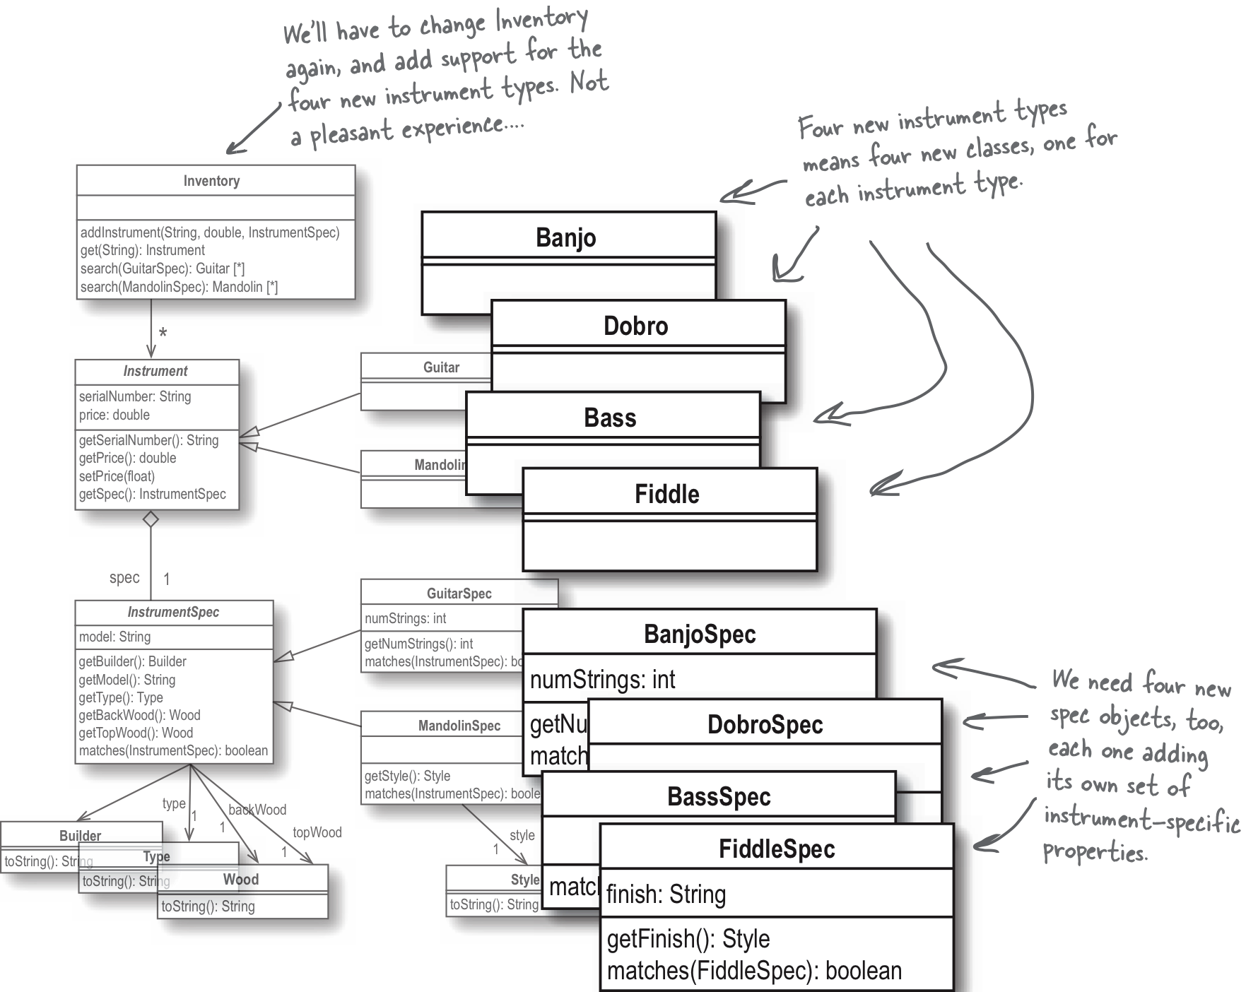
Rick Wants More Instruments!
YIKES!
Our design doesn’t
scale very well ...
Head First Object-Oriented
Analysis & Design
by Brett D. McLaughlin, et al.
O’Reilly, 2006.

Slide 29
Our Design Doesn’t Scale Very Well
For each new instrument:
We need to add a subclass of Instrument.
We need to add a subclass of InstrumentSpec.
In class Inventory, we need to add:
a new search() function
a new type test in the add_instrument() function

Slide 30
Time to Revisit Our Design!
Having all those Instrument and InstrumentSpec subtypes may not be such a good idea after all.

Slide 31
Time to Revisit Our Design! cont’d
What varies among the instrument classes?
properties
matching algorithm
What doesn’t vary?
manufacturer
type
price
serial number
What should we do
with stuff that varies?

Slide 32
Encapsulation to the Rescue!
If we can encapsulate the varying instrument properties in one place, we can get rid of all the Instrument and InstrumentSpec subclasses.
Then both the Instrument and InstrumentSpec classes can become concrete classes (instead of being abstract).

Slide 33
Encapsulation to the Rescue!
Instrument properties vary across the instrument types.
A guitar has some different properties than mandolins.
Encapsulate the varying properties in a hash table.
Pairs of property name and property value
Each type of instrument can have a different set of properties.

Slide 34
Revised InstrumentSpec Class
enum class ValueType
{
INTEGER, STRING,
};
struct Property
{
ValueType type;
union
{
int ivalue;
string svalue;
};
Property(int value) : type(ValueType::INTEGER), ivalue(value) {}
Property(string value) : type(ValueType::STRING)
{
new (&this->svalue) string(value);
}
};

Slide 35
Revised InstrumentSpec Class, cont’d
class InstrumentSpec
{
public:
InstrumentSpec(map<string, Property *> *properties);
map<string, Property *> *get_properties() const;
bool matches(InstrumentSpec *other_spec);
private:
map<string, Property *> *properties;
string to_lower(string str);
};

Slide 36
Revised InstrumentSpec Class, cont’d
bool InstrumentSpec::matches(InstrumentSpec *other_spec)
{
map<string, Property *>::iterator it;
for (it = properties->begin(); it != properties->end(); it++)
{
pair<string, Property *> p = *it;
string key = p.first;
Property *this_property = p.second;
Property *other_property = (*other_spec->get_properties())[key];
if (other_property != nullptr)
{
if (this_property->type != other_property->type) return false;
if (this_property->type == ValueType::INTEGER)
{
if (this_property->ivalue != other_property->ivalue) return false;
}
else
{
if (this_property->svalue != other_property->svalue) return false;
}
}
}
return true;
}
Iterate over the properties
of an instrument specification.
This generic matching algorithm works
with any instrument type’s properties.

Slide 37
Re-revised Inventory Class
void Inventory::add_instrument(string serial_number, double price,
InstrumentSpec *spec)
{
Instrument *instrument = new Instrument(serial_number, price, spec);
inventory.push_back(instrument);
}

Slide 38
Re-revised Inventory Class
list<Instrument *> Inventory::search(InstrumentSpec *search_spec)
{
list<Instrument *> matching_instruments;
list<Instrument *>::iterator it;
for (it = inventory.begin(); it != inventory.end(); it++)
{
Instrument *instrument = *it;
InstrumentSpec *instrument_spec = instrument->get_spec();
if (instrument_spec->matches(search_spec))
{
matching_instruments.push_back(instrument);
}
}
return matching_instruments;
}
Only one search() function needed!

Slide 39
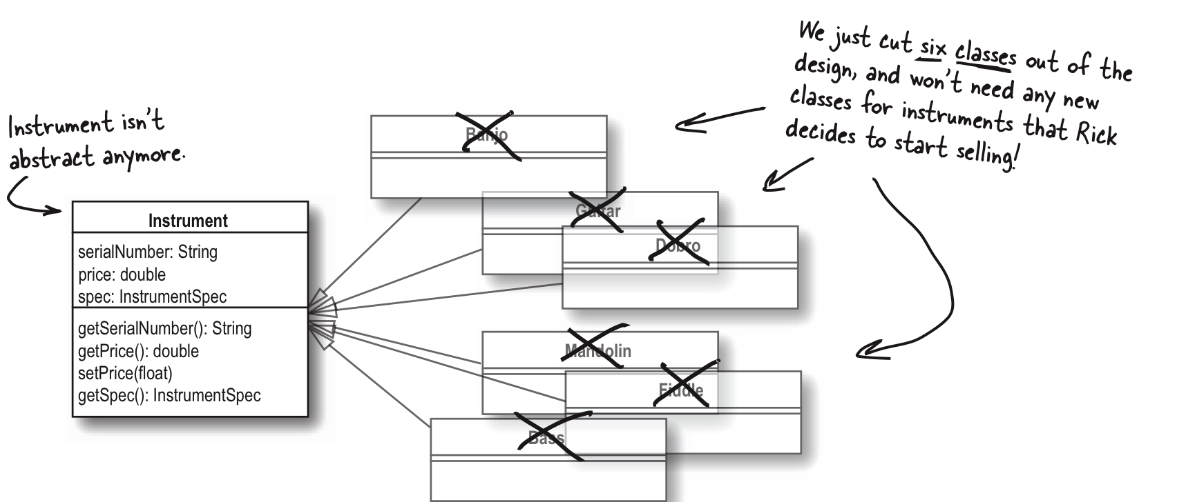
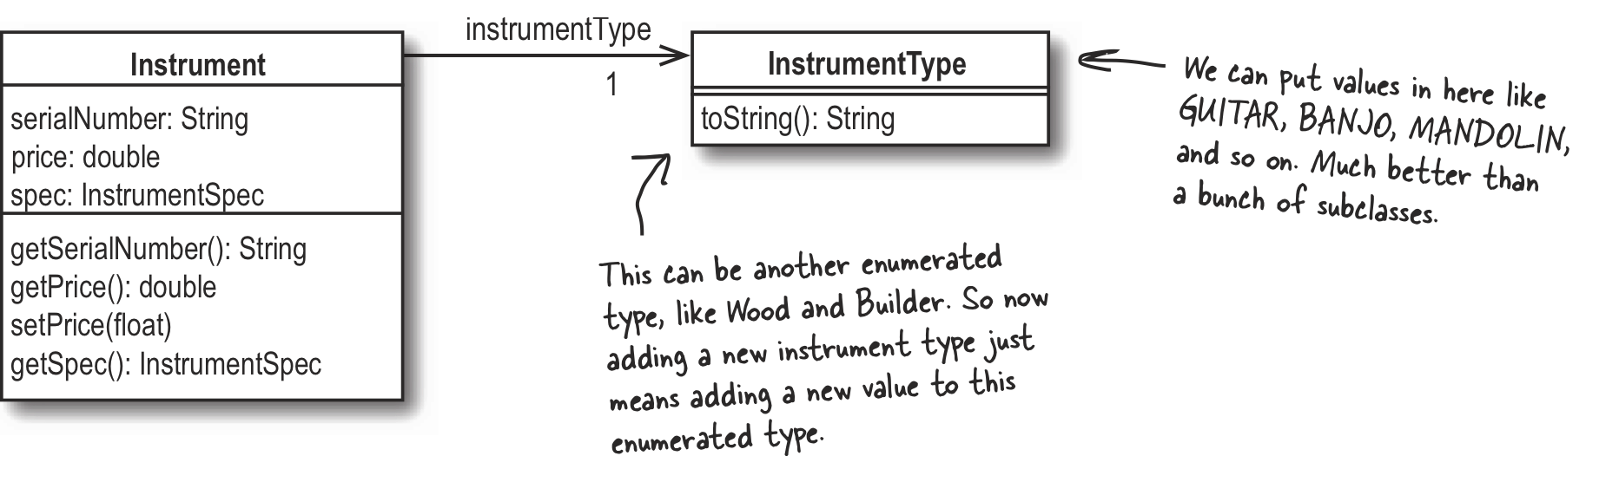
Improved Design
Head First Object-Oriented
Analysis & Design
by Brett D. McLaughlin, et al.
O’Reilly, 2006.

Slide 40
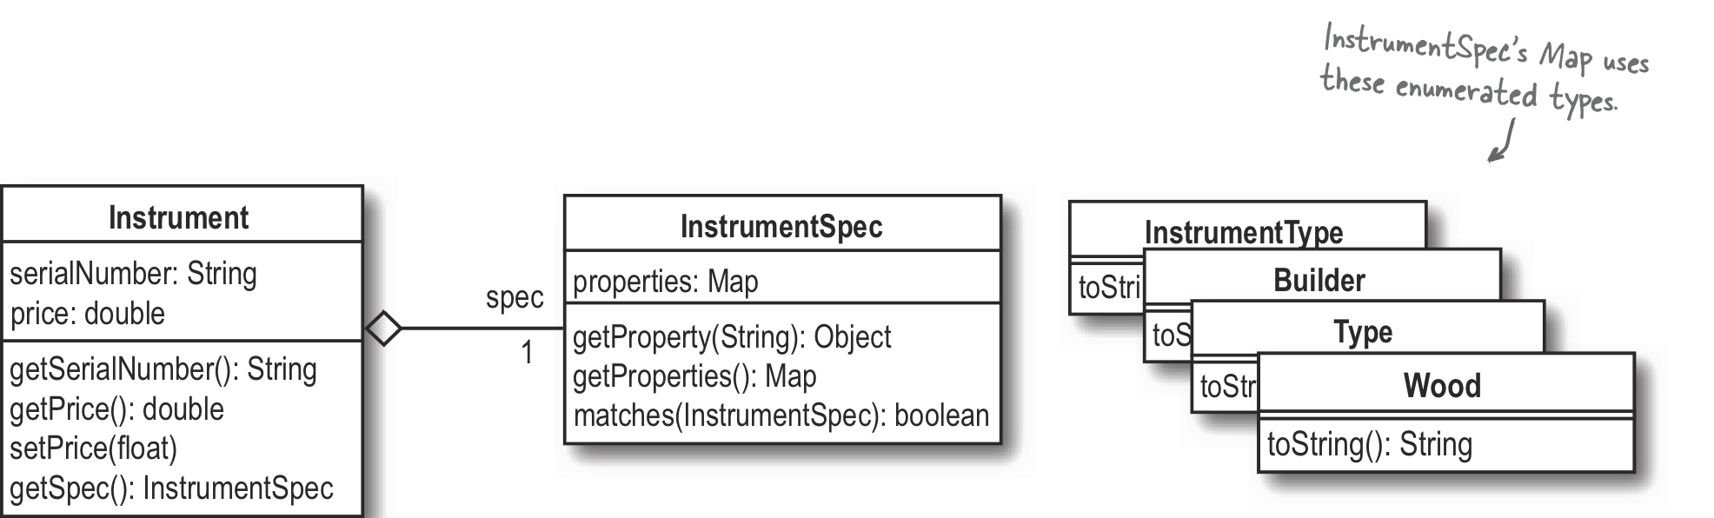
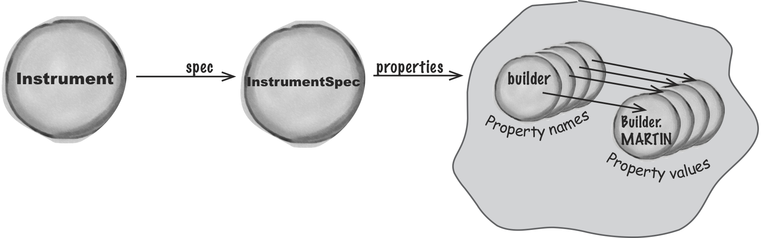
Improved Design, cont’d
Head First Object-Oriented
Analysis & Design
by Brett D. McLaughlin, et al.
O’Reilly, 2006.

Slide 41
Conclusions
It takes a journey to achieve Good Design.
iterative improvements
wrong paths
backtracking
Developing Great Software can be a messy business!
Be willing to fix your own bad design decisions.

